Slide 1



New Resident Briefing
Housing Choice Voucher Program
(Section 8)
The New Reidsville Housing Authority

Slide 2

  Admissions At A Glance
1. Applicant Briefing
2. Housing Choice Voucher issued
3. Applicant searches for new home
Home found… Landlord completes the “Request for Tenancy Approval” Form

Slide 3


What’s in the Packet?

Slide 4


Expect to read through the packet
SEVERAL TIMES!
There are lots of good resources
included in the packet!

Slide 5
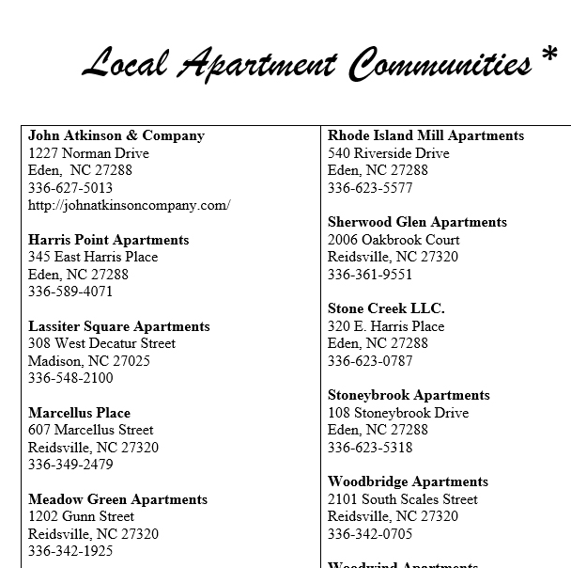

Slide 6
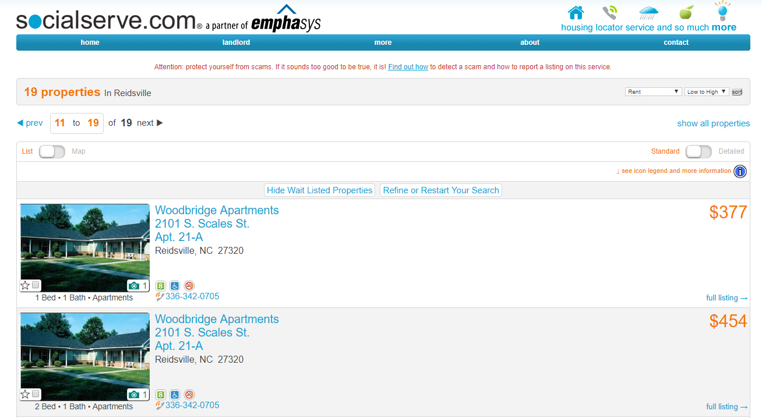
SOCIALSERVE.COM

Slide 7


Slide 8
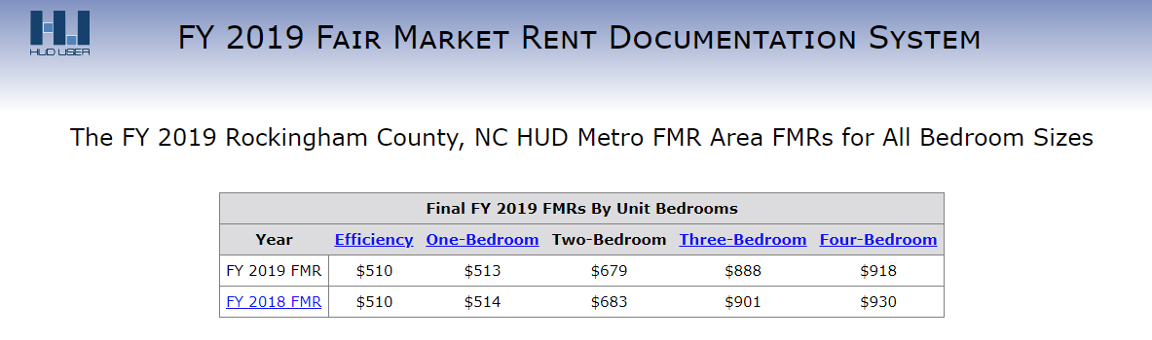
POLICIES
Voucher Extension and Expiration
Fair Market Rent

Slide 9

POLICIES
Calculation of Your Rent
Tenant Screening

Slide 10
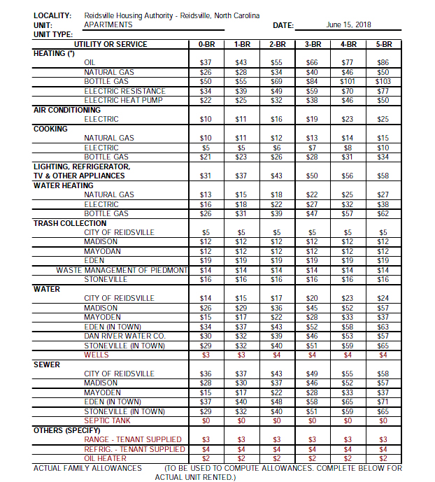
POLICIES
Sample Utility Allowance

Slide 11


FAMILY RESPONSIBILITIES

Slide 12
FAMILY RESPONSIBILITIES
(Interim Changes in Income)
What happens if my income changes or if I start a new job after having been out of work?
(Changes in Family Composition)
  What happens if the makeup of my family changes?
  Divorce
  I’ve had a baby

Slide 13
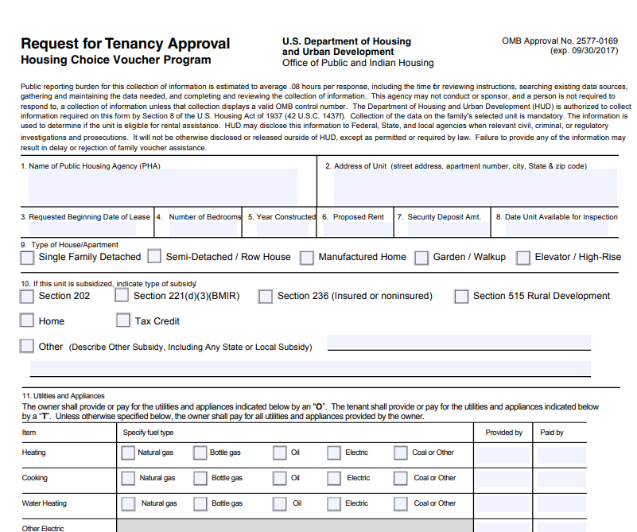

Slide 14
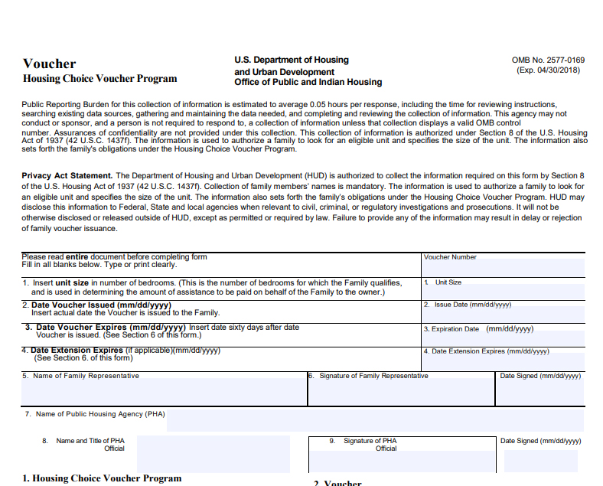

Slide 16
What happens after I receive my voucher…?

Slide 17
Admissions At A Glance (Continued)
Before you can move in
Your new home must be inspected by the Housing Authority
Repairs are
not completed
Unit Passes
Unit Fails
Landlord, Tenant, and HA sign HAP CONTRACT
Landlord Advised of
Required Repairs
Landlord & Tenant
sign separate Lease
Landlord completes repairs
(Go to Unit Passes)
Applicant
must search
For new home

Slide 18

Participant Eligibility
Must be a U.S citizen, national or non-citizen with eligible immigration status.
Must have an active application on file.
Must meet the income guidelines as published by HUD.
Notes:
(Do not advance slide till entire “Introduction” is read
INTRODUCTION
The New Reidsville Housing Authority (RHA) is the administering agency for the Section 8 Rental Housing Choice Voucher Program. The program is designed to provide income eligible families the opportunity to live in safe, decent and sanitary housing. The program benefits the participant as well as the owner/agent of the leased housing unit. By providing a rent subsidy, Section 8 affords the participant the opportunity to seek better housing or remain in their existing decent, good quality housing. The landlord benefits because they are guaranteed payment, either full or partial monthly rent.
RHA operates in compliance with all state laws, which assure fair and equal housing opportunities to all persons. No U.S. citizen or non-citizen of eligible status will be excluded from participating in, or denied the benefits of the Section 8 Housing Choice Rental Program on the grounds of age, race, color, religion, sex, disability, national origin or familial status.
ADVANCE SLIDE TO FIRST BULLET NOW
Must be a U.S citizen, national or non-citizen with eligible immigration status.
Must have an active application on file.
Must meet the income guidelines as published by HUD.

Slide 19

Housing Authority Obligations
1. Receive applications from families requesting housing assistance.
2. Maintain Waiting List.
3. Select families to be assisted from the waiting list.
4. Issues a Voucher that indicates the length of time a family has to actively seek housing, and the appropriate bedroom size.

Slide 20

Housing Authority Obligations
5. Provide housing information to selected families including information on the hazards of lead-based paint.
6. Review Request for Tenancy Approval of home selected by the family.
7. Inspect the selected home prior to providing housing assistance and reinspect annually, to ensure compliance with Housing Quality Standards.
8. Determine if Landlord requested rent is reasonable and affordable to family.

Slide 21

Housing Authority Obligations
9. Determine the amount of housing assistance and the family’s share of the rent to the landlord.
10. Provide written notice of terminations to all parites when violations have occurred.
11. Maintain family data and profile. Schedule exams annually to keep information up to date.
12. Provide landlords and participants with prompt professional service.

Slide 22

Landlord Obligations
Perform all management and rental functions for the unit
2. Participant screening and selection
3. Collect security deposits
4. Prepare lease agreement with the family
5. Collecting participant share of rent and other tenant charges for damage to the unit whenever appropriate.

Slide 23
Landlord Obligations
6. Provide maintenance for your home in accordance with Housing Quality Standards (HQS).
7. Provide information to the family, on the status of lead-based paint in the unit.
8. Comply with Equal-Opportunity requirements.
9. Comply with the Housing Assistance Payments (HAP) Contract.
10. Enforce the Lease.
11. Pay for owner supplied utilities and services.
12. Provide reasonable accommodations when requested.

Slide 24

Family Do’s and Don’ts
The family must follow the following rules in order to continue participating in the Section 8 New Housing Choice Voucher program.
These are just some of the rules…..

Slide 25
Do
Supply true and complete information to the Housing Authority when requested.
Make sure all residents of the unit are approved by the HA.
Notify the HA of any birth, adoption or court awarded custody of a child.
Allow the HA to inspect the unit.
The family must notify the HA and owner before moving out of the unit or terminating the lease.

Slide 26
Do
The family must provide information when requested to allow the HA to verify that the family is living in the unit,
including any information on family absences.
The family must cooperate with the HA.

Slide 27
Don’ts
The family must not cause a breach in (HQS).
a. Poor Housekeeping
b. Fail to maintain Tenant supplied utilities
c. Must Maintain Appliances furnished to the family
d. Damage beyond normal wear and tear caused by family members or their guests are the responsibility of the FAMILY.

Slide 28

Grounds for Termination
Committing fraud, bribery or any other corrupt or criminal act in connection with the program is grounds for immediate eviction and termination from the program.
Drug-related or violent criminal activity or alcohol abuse in a way that threatens the health, safety or rights to peaceful enjoyment of other residents, is also grounds for immediate eviction and termination from the program..

Slide 29

Grounds for Termination
If the family violates any family obligation.
If any member of the family is responsible for drug-related or violent criminal activity or the abuse of alcohol to the extent that it interferes with the health, safety, or right to peaceful enjoyment of the premises by other residents.
Notes:
The Housing Authority may at anytime deny program assistance for an applicant or terminate program assistance for a participant for any of the following grounds:

Slide 30


The Family Must…
Provide any utilities, e.g. electricity, gas or water, which are not furnished by the owner.
Provide and maintain any appliance that the owner does not furnish, such as a stove or refrigerator.
Repair any damages to the unit or premises (beyond normal wear and tear) that result in a breach of the HQS.
Notes:
The family obligations to the owner are contained in the lease agreement. Families are obligated to pay the rent on time and to take care of the housing unit. Generally, the owner is required to make repairs and provide routine maintenance. However, if a housing unit fails to meet Housing Quality Standards because of the following items, it is the responsibility of the family to make the corrections.

Slide 31

Grounds for Denial or Termination of Assistance
4. If any member of the family commits fraud, bribery or any act of corruption in connection with any HUD program.
5. If the family currently owes money to any HA in connection with any public housing assistance program.
6. If the family has not reimbursed any HA for amounts paid to an owner for rent damages or other amounts due under the lease.

Slide 32

Grounds for Denial or Termination of Assistance
9. If the family has remained at zero assistance for over six months.
If the family has engaged in or threatened abusive or violent behavior toward HA personnel.
This includes verbal as well as physical abuse or violence; use of expletives that are generally considered insulting, racial epithets, or other language, written or oral, which is customarily used to insult or intimidate.

Slide 33

Rent Reasonableness
Rents charged for comparable units in the private unassisted market, or rents charged by the owner for a comparable unassisted unit in the building or premises.
The HA will not approve an initial rent or a rent increase without determining that the rent amount is reasonable.
Notes:
Rent reasonableness is used to ensure that a fair rent is paid for units on the Section 8 program, and that the program does not have the effect of inflating rents in the community. HA s must certify and document on a case-by-case basis that the approved rent is not more than:
<click> Rents charged for comparable units in the private unassisted market, or rents charged by the owner for a comparable unassisted unit in the building or premises.
<click> The HA will not approve an initial rent or a rent increase without determining that the rent amount is reasonable.
In making a rent reasonableness determination, the Housing Authority will compare the rent for the unit to the rent of comparable units in the same or comparable neighborhoods. The Housing Authority will consider the location, quality, size, and number of bedrooms, age, amenities, housing services, maintenance and utilities of the unit and the comparable units.

Slide 34
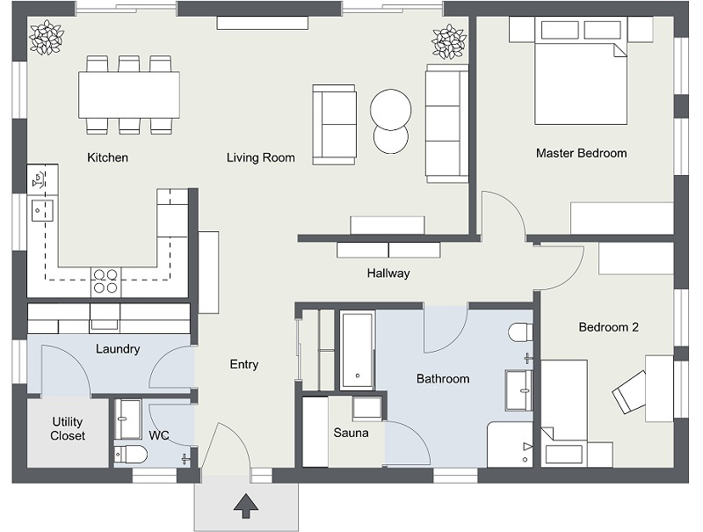
Assignment of Bedroom Sizes
Number of Bedrooms | Number of People
 | Minimum | Maximum
0 | 1 | 1
1 | 1 | 2
2 | 2 | 4
3 | 3 | 6
4 | 4 | 8
5 | 6 | 10
6 | 8 | 12
Notes:
The GHA will issue a voucher for a particular bedroom size. The Bedroom size is a factor in determining the family’s level of assistance. The following guidelines will determine each family’s unit size without overcrowding or over-housing:
<click to bring up table>
These standards are based on the assumption that each bedroom will accommodate no more than two (2) persons.
In determining bedroom size, the GHA will include the presence of children to be born to a pregnant woman, children who are in the process of being adopted, children whose custody is being obtained, children who are temporarily away at school or temporarily in foster-care.

Slide 35

Assignment of Bedroom Sizes
Bedroom size will also be determined using the following guidelines:
Children of the same sex will share a bedroom.
Children of the opposite sex will not share a bedroom.
Adults and children will not be required to share a bedroom.
Foster-adults and children will not be required to share a bedroom with a family member.
Live-in aides will get a separate bedroom.
Notes:
Bedroom size will also be determined using the following guidelines:
<click> Children of the same sex will share a bedroom.
<click> Children of the opposite sex will not share a bedroom.
<click> Adults and children will not be required to share a bedroom.
<click> Foster-adults and children will not be required to share a bedroom with family member.
<click> Live-in aides will get a separate bedroom.
GHA will grant exceptions to normal occupancy standards; when a family requests a larger size than the guidelines allow and documents a medical reason why the larger size is necessary.
The family unit size will be determined by GHA in accordance with the above guidelines and will determine the maximum rent subsidy for the family; however the family may select a unit that may be larger or smaller that the family unit size. If the family selects a smaller unit, the payment standard for the smaller size will be used to calculate the subsidy. If the family selects a larger size, the payment standard for the family size will determine the maximum subsidy.
Participants will be allowed to use non-sleeping areas (excluding kitchens and bathrooms) as a bedroom subject to landlord approval; however, the Payment Standard shall be based on the size indicated on the Voucher or unit size selected whichever is smaller. In these exceptions, GHA reserves the right to approve or disapprove such accommodations that may lead to unsafe or overcrowded conditions.

Slide 36
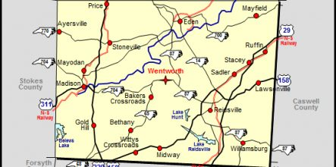
Where Can I Get an Apartment?
With your Voucher you may lease a unit anywhere in Rockingham County.
If you locate a unit outside the jurisdiction of The New Reidsville Housing Authority, you will need to exercise portability, if you are eligible . Usually you will not be eligible to port unless you have been on Section 8 for at least 1 year.
Notes:
WHERE FAMILY MAY LEASE A UNIT/NOTICE OF PORTABILTY
<click> With your Voucher you may lease a unit anywhere in the city of Greensboro and Guilford County with the exception of the City of High Point. If you locate a unit outside the Greensboro Housing Authority’s (GHA) jurisdiction, you will need to exercise portability, if you are eligible under GHA portability policy.

Slide 37

What To Do When You Find A Place To Live
Make an appointment with the owner or manager to see the unit (inside and outside)
Request Landlord fill out Tenancy Approval Form
The Request for Tenancy Approval and the Lead-Based Paint Certification must be returned to RHA.
When the unit passes inspection, you may move in.
But not until the Utilities are turned on!!!
Sign a lease and lease addendum
Notes:
WHAT TO DO WHEN YOU FIND A PLACE WHERE YOU WANT TO LIVE
When you find a place you like, <click> make an appointment with the owner or manager to see the unit (inside and outside). Talk to the owner/manager about the rent and determine if the rent is lower than the maximum that can be charged for the unit. If you are sure that you want to rent the unit, have the owner/manager fill out the <click> Request for Tenancy Approval and both of you will need to sign the Lead-Based Paint Certification.
<click>The Request for Tenancy Approval and the Lead-Based Paint Certification must be returned to the section 8 departments. When we receive the forms we will determine if your income support the rent being charged by the owner/manager before scheduling an initial inspection and we will make sure the rent asked for by the owner/manager is reasonable. If the rent is reasonable we will call the owner/manager to schedule an initial inspection. <click> When the unit passes inspection, you may move in.
When doing the inspection, we must have all of the <click> utilities on. You and the owner/manager will need to discuss who will have the utilities on. When you are ready to move in, you and the owner/manager must <click> sign a Lease and Lease Addendum. Copies of both need to be given to the Section 8 department for your file.
INFORMATION WE GIVE TO THE LANDLORD
The only information about you that the Section 8 department will give to a landlord is your current address and the names and addresses of your current landlord if we know it. We will make an exception to this if your whereabouts must be protected due to domestic abuse or witness protection. We tell landlords that it is their responsibility to determine the suitability of their tenants. We encourage owners to screen their applicants for rent payment history, damage to units, and other factors related to the suitability of an applicant.

Slide 38

If You Need An Extension
Request the extension prior to the original expiration date
One extension for 30 days will be granted.
If needed, another thirty-day extension will be granted for persons with disabilities.
Notes:
EXTENSIONS
If you have not found a unit to rent within the 60-day period that your housing choice voucher was issued you may request an extension. However, your request for an extension must be made <click> prior to the original expiration date.
<click> One extension for thirty days will be granted. If needed, another thirty-day extension will be granted for persons with disabilities.
To request an extension, you must contact your Housing Specialist and request an extension form, at which time an appointment will be scheduled for you to come into the office and discuss any difficulties you might have in securing a unit; you should also provide a copy of the housing search log at that time. No extension will be granted without the housing search documentation.
Extensions will be granted primarily for the following reasons:
Extenuating circumstances such as hospitalization or a family emergency for an extended period of time, which has affected your ability to find a unit within the initial period. Written verification will be required from the source.
The Section 8 staff is satisfied that you have made a reasonable effort to find a unit, including seeking the assistance of Section 8 staff, throughout the initial period, if you have not found a unit in 30 days you should contact your Housing Specialist to get additional names of owner’s not on the owner’s list. These owners’s only list their units as they become available.
You have been prevented from finding a unit due to disability accessibility requirements or large size bedroom unit requirements.
SUSPENSION OF A HOUSING CHOICE VOUCHER
The time limit on the housing choice voucher will be suspended while a Request for Tenancy Approval is being processed.

Slide 39

The New Reidsville Housing Authority New Resident Briefing
© Copyright 2019 – The New Reidsville Housing Authority

